Slide 1
AIRLINE RESERVATION SYSTEM

Slide 2
INTRODUCTION
AIRLINE RESERVATION SYSTEM

Slide 3
MODULES
AIRLINE RESERVATION SYSTEM
Airline Reservation system contains 2 modules
Admin Module
User Module

Slide 4
FLOW DIAGRAM : ADMIN MODULE

Slide 5
FLOW DIAGRAM : USER MODULE

Slide 6
ADMIN MODULE

Slide 7
USER MODULE

Slide 8
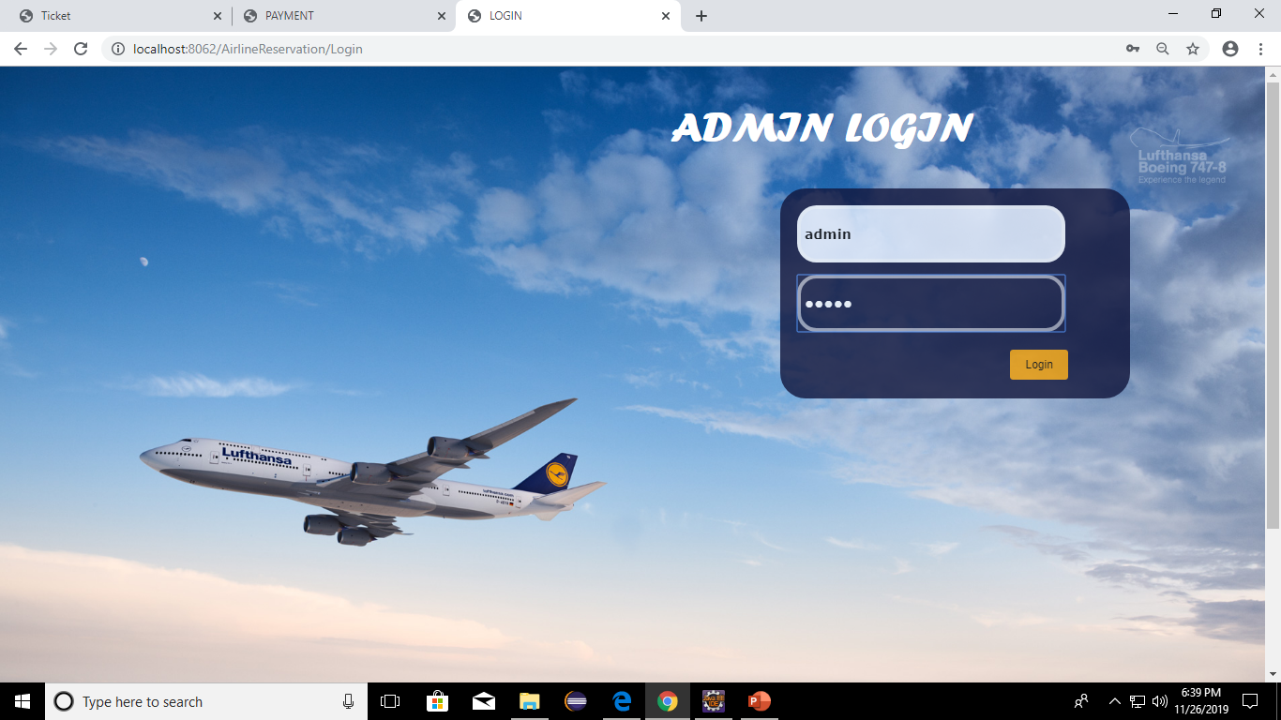
SNAPSHOTS : ADMIN MODULE
Admin Login

Slide 9
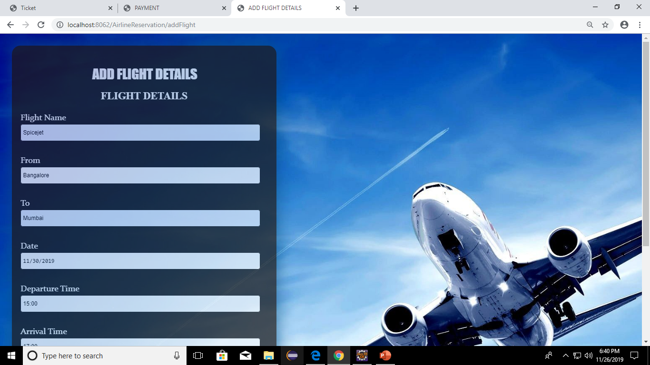
SNAPSHOTS : ADMIN MODULE

Slide 10
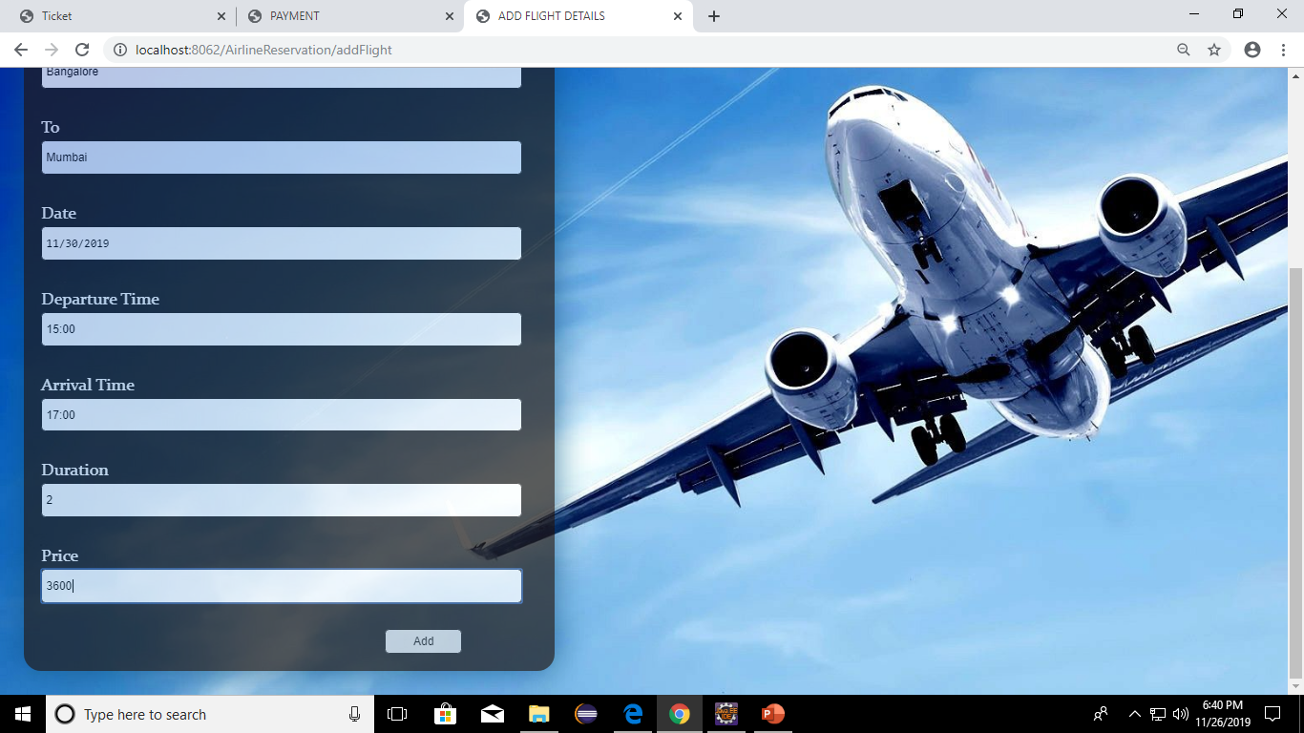
SNAPSHOTS : ADMIN MODULE

Slide 11
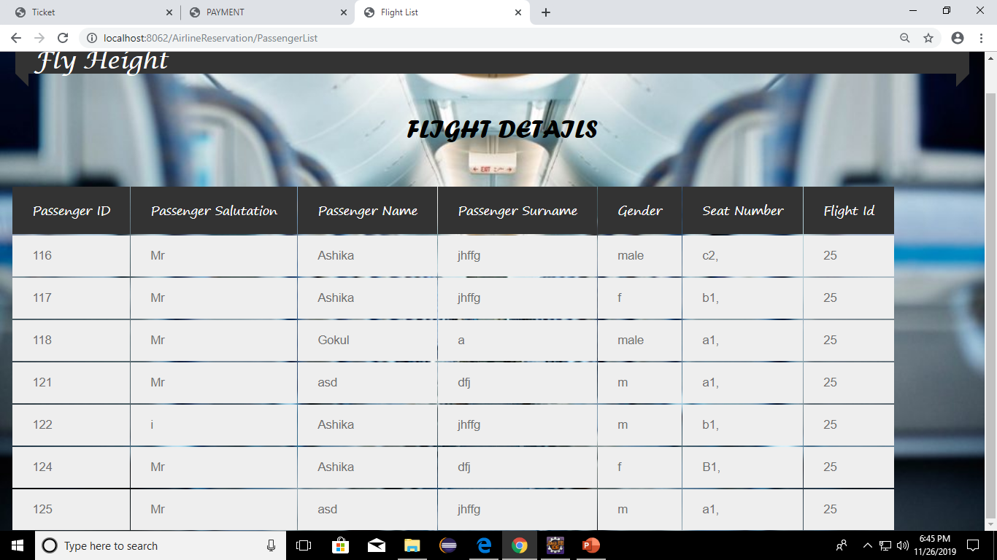
SNAPSHOTS : ADMIN MODULE

Slide 12
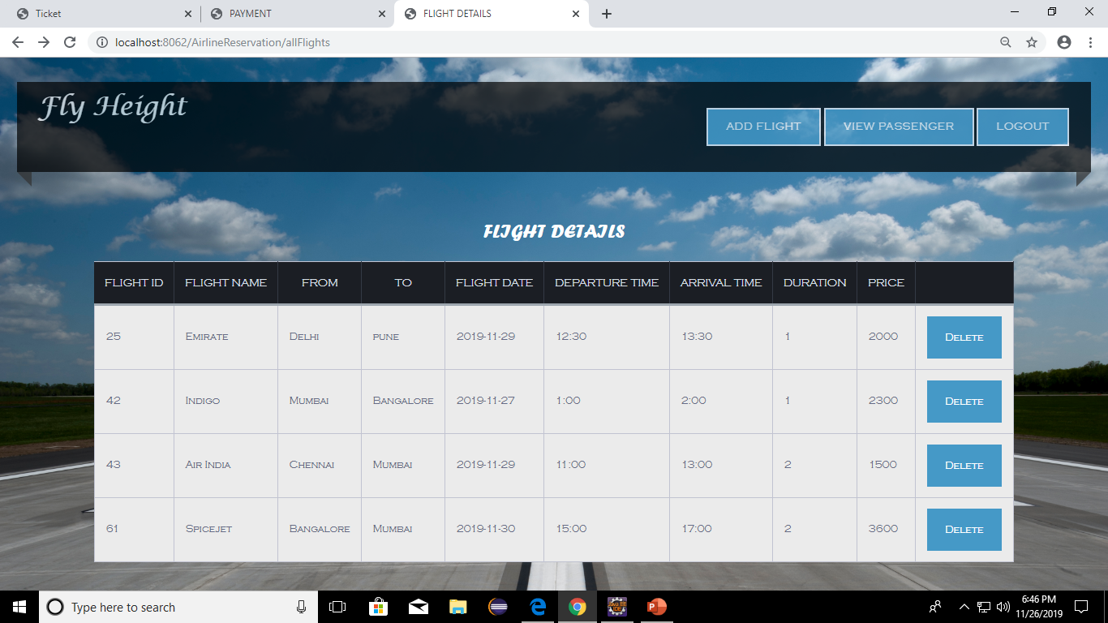
SNAPSHOTS : ADMIN MODULE

Slide 13
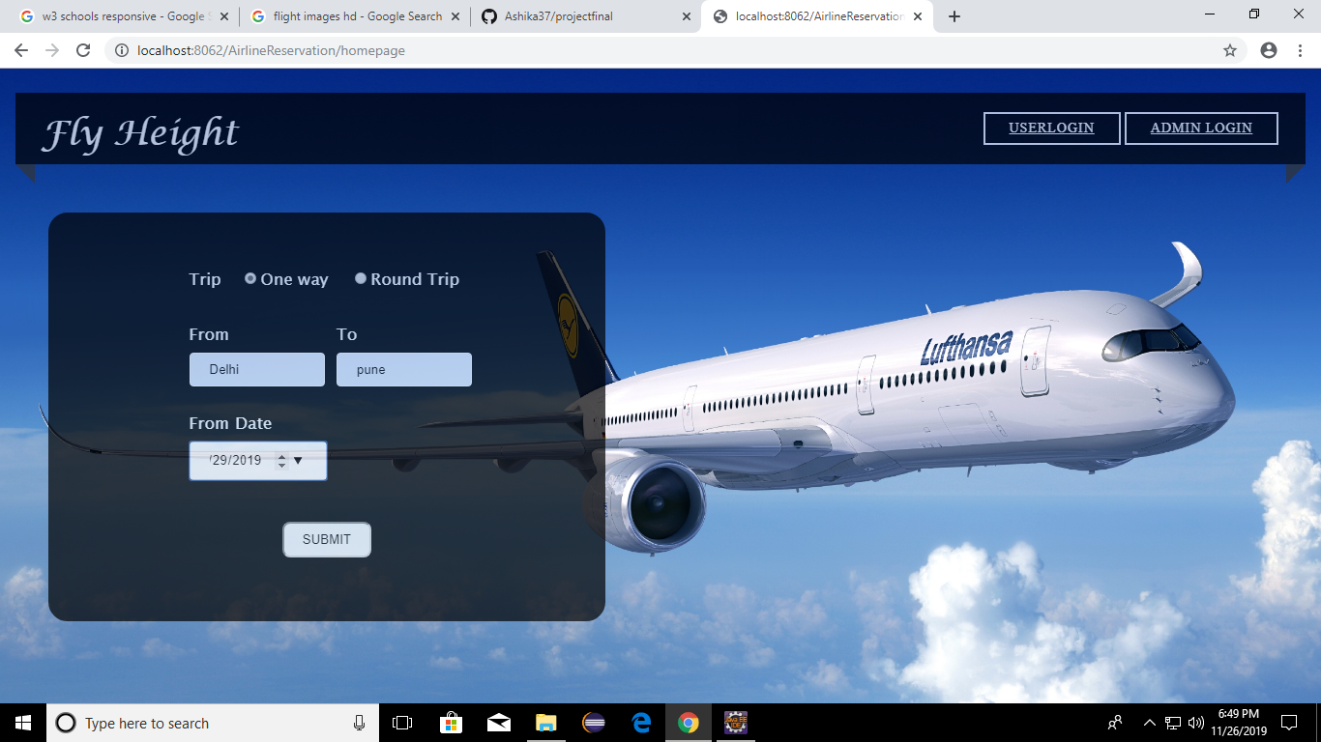
SNAPSHOTS : USER MODULE

Slide 14
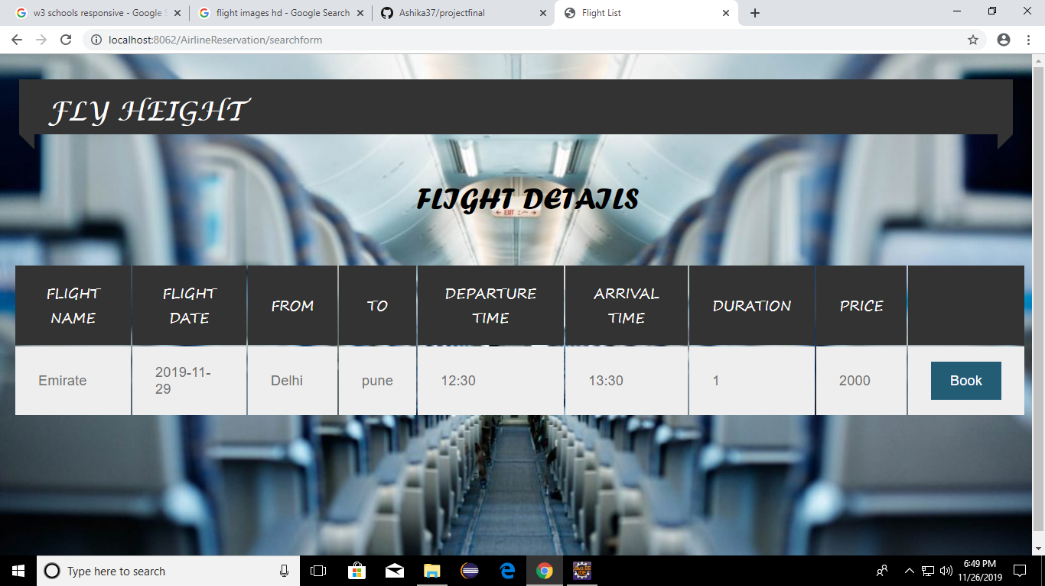

Slide 15
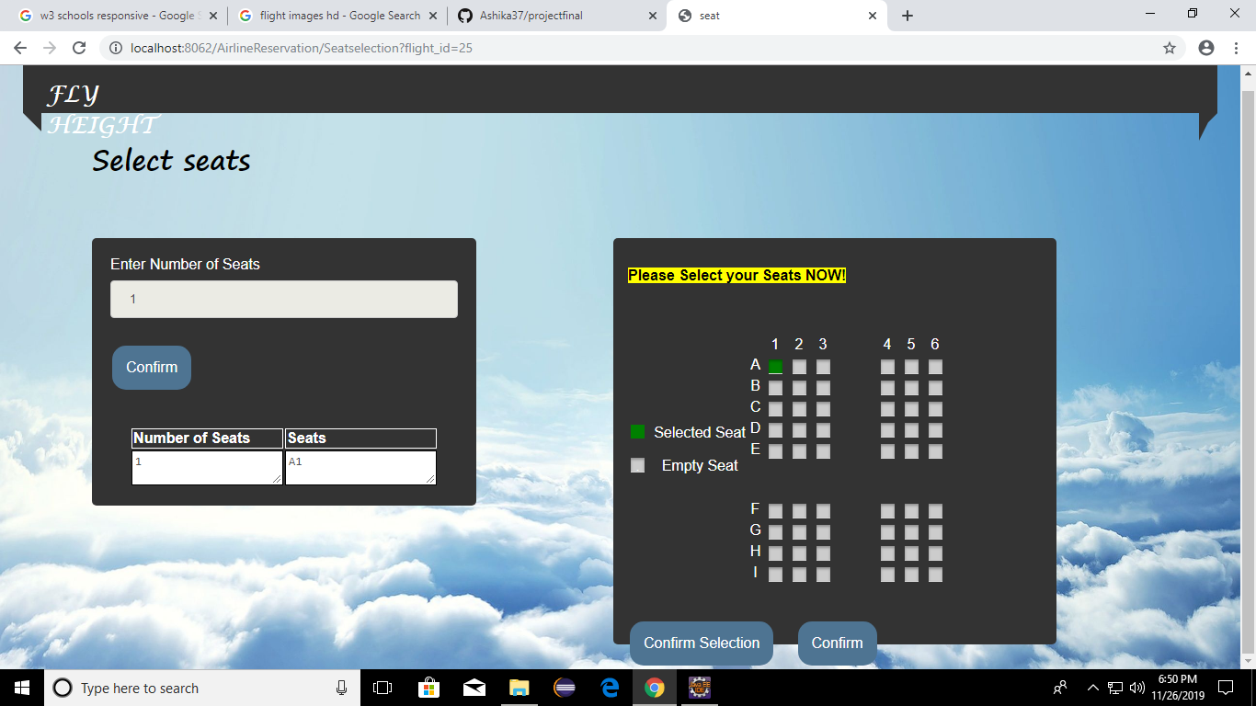

Slide 16
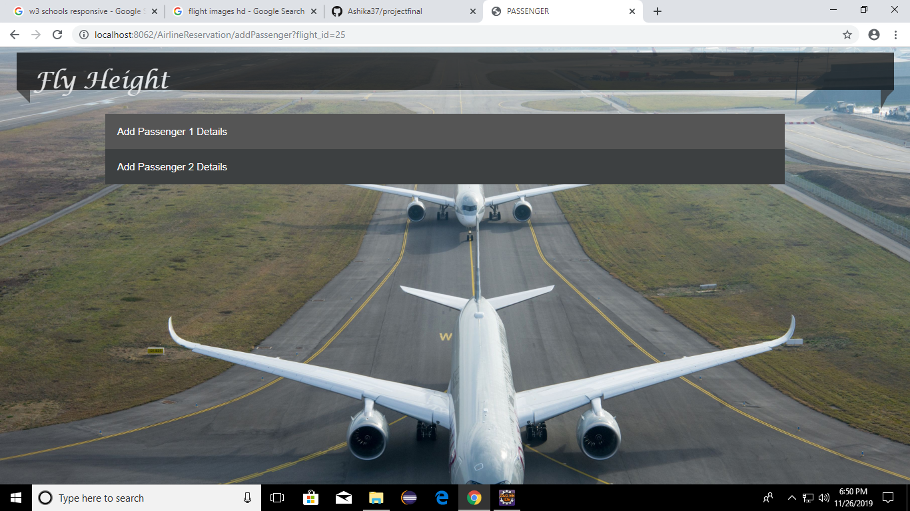

Slide 17
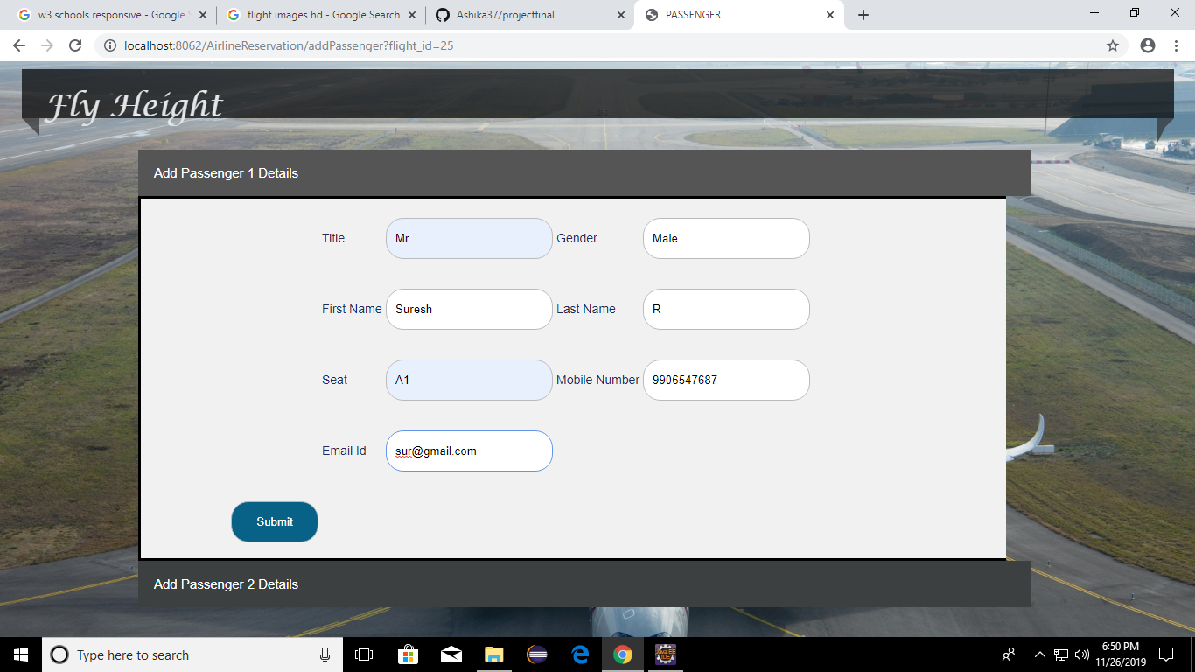

Slide 18
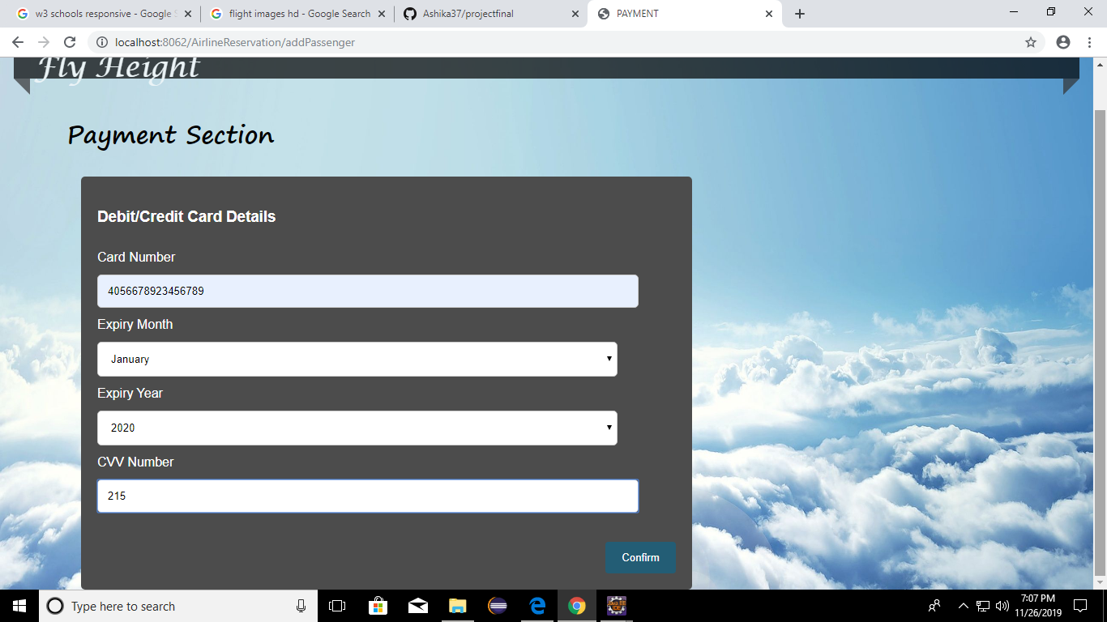

Slide 19
